Slide 1
ANALYSIS OF BUSINESS OPERATION EXPENSES: A CASE STUDY DURING MY INTERNSHIP AT SMARTBRIDGE
Introduction :
. Companies are constantly striving to optimize their resources while minimizing costs in various operational areas. During my internship at SmartBridge, an EdTech startup in Hyderabad, I had the opportunity to observe and analyze different cost components of business operations. This study focuses on key operational expenses, including payroll, operating expenses, maintenance, taxes, power expenditure, labor costs, transportation, warehousing, and advertisement costs. The aim is to provide a comprehensive understanding of these expenses and suggest strategies for their optimization.
→The study also incorporates a review of relevant literature to compare SmartBridge’s practices with industry standards and best practices.
→ “SmartInternz," Project Based Learning & Remote Internship Platform serves as a catalyst for fostering collaboration between academia and industry.
→This report summarizes my 4-week financial Analyst internship, highlighting key activities and learnings each week. It includes insights gained, practical skills developed, and overall progress made during the training period.

Slide 2
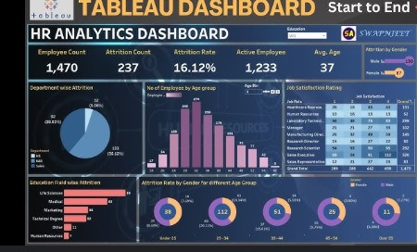
TABLEAU DASHBOARD :

Slide 3
FINDINGS
Payroll and operational costs (maintenance and utilities) were identified as the most substantial expense categories.
Although technology and software-related expenses were high, they were essential for maintaining operational efficiency and competitiveness.
Using Tableau for data visualization significantly improved the ability to communicate complex data effectively.
Engaging with the finance team and management throughout the process was critical in refining the analysis and ensuring that the recommendations were practical and aligned with the company's strategic goals.

Slide 4
SUGGESTIONS:
The company should consider implementing the cost-saving recommendations, particularly in operational areas.
Reviewing and negotiating vendor contracts could lead to further savings.
The company should continually assess the return on investment (ROI) and explore options for more cost-effective solutions where possible.
Conducting regular audits of expenses can help the company stay on top of potential inefficiencies and prevent cost overruns.
Providing training to employees on cost-consciousness and financial efficiency could foster a culture of saving across the organization

Slide 5
CONCLUSION
The internship provided a comprehensive understanding of financial management, particularly in analyzing and optimizing business expenses. Through detailed data collection, analysis, and visualization, key areas for cost savings were identified. The project demonstrated the importance of collaboration with stakeholders and the practical challenges involved in implementing financial strategies. The experience significantly enhanced my analytical, presentation, and communication skills. By the end of the project, actionable recommendations were made that, if implemented, could contribute to the company’s financial health and efficiency.

Slide 6
Team leader : Balaji L Team member : Manoj Kumar Jeeturi
THANKYOU

